Slide 1
Chapter 1 : History of Computing
Prehistory of Computing
History of Computer Hardware
History of Software: Programming Languages and Operating Systems
History of Networking
Pioneers of Computing

Slide 2
Prehistory of Computing
Counting on fingers
Counting on Pebbles
Counting marks on the walls
Counting marks on the bones
Counting marks in the sand

Slide 3
Prehistory of Computing
ﬁrst numbers recorded on animal bones and rocks(between 20,000 BC and 30,000 BC)
the invention of the abacus, the device many believe was the mother of the digital computer as we know it today, between 1000 BC and 500 BC
Zero and negative numbers were ﬁrst used between 300 BC and 500 AD.
period between 1500 and 1900 saw a surge of activity in the development of computing devices
In 1500, the computing community got a boost when Leonardo da Vinci invented a mechanical calculator

Slide 4
Prehistory of Computing
In 1500, the computing community got a boost when Leonardo da Vinci invented a mechanical calculator
followed by the invention of the slide rule in 1621
followed by Wilhelm Schickard’s mechanical calculator in 1625 and by Blaise Pascal’s arithmetic machine 15 years later.
The major breakthrough in speed came in 1800 with the invention of the punched card by Joseph Marie Jacquard, a French silk weaver
it was used not only to speed up computation but also to store information.

Slide 5
Prehistory of Computing
there were successive history-making inventions starting with Charles Babbage’s analytical engine in 1830 and George and Edward Schutz’s difference engine.
followed by one of the milestone inventions in computing and mathematics—George Boole’s development of Boolean algebra.
Sir Charles Wheatstone’s invention of the paper tape to store information in 1857 created new excitement in the computing community of the time

Slide 6
Prehistory of Computing
invention of the logic machine by William Stanley Jevons in 1869,
the invention of the ﬁrst keyboard by Sholes around 1874,
the rectangular logic diagrams by Allan Marquand in 1881.
Starting around 1890, a burst of major inventions similar to those of 1850s started all over again

Slide 7
Prehistory of Computing
In 1886, Charles Pierce ﬁrst linked Boolean algebra to circuits based on switches, a major breakthrough in mathematics, engineering, and computing science.
In 1890, John Venn created the Venn diagrams now used extensively in switching algebras in both hardware and software development.
Finally, in 1890, Herman Hollerith invented the tabulating machine

Slide 8
Prehistory of Computing
the second period of development that started around the turn of the twentieth century
The century began with a major milestone in the computing history—the invention of the vacuum tube by John Ambrose Fleming.
All digital computers in the ﬁrst half-century ran on vacuum tubes.
The year 1926 saw the invention of the ﬁrst semiconductor transistor, which would come to dominate the computing industry from that point forward.

Slide 9
History of Computer Hardware
First Generation (1940-1956)
Vacuum Tubes
Second Generation (1956-1963)
Transistors
Third Generation (1963-1971)
Integrated Circuits
Fourth Generation (1971- Present)
Microprocessor
Fifth Generation (Present and Beyond)
Artificial Intelligence

Slide 10
History of Computer Hardware
First Generation
The period 1940 to 1956, roughly considered as the First Generation of Computer.
The first generation computers were developed by using vacuum tube or thermionic valve machine.
The input of this system was based on punched cards and paper tape; however, the output was displayed on printouts.
The first generation computers worked on binary-coded concept (i.e., language of 0-1).

Slide 11
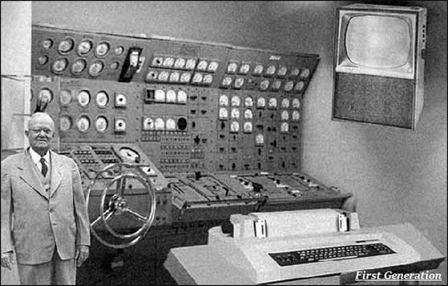
History of Computer Hardware

Slide 12
History of Computer Hardware
The main features of the first generation are −
Vacuum tube technology
Unreliable
Supported machine language only
Very costly
Generated a lot of heat
Slow input and output devices
Huge size
Need of AC
Non-portable
Consumed a lot of electricity

Slide 13
History of Computer Hardware
Some computers of this generation were −
ENIAC
EDVAC
UNIVAC
IBM-701
IBM-650

Slide 14
History of Computer Hardware
Advantages:
It made use of vacuum tubes which are the only electronic component available during those days.
These computers could calculate in milliseconds.
Disadvantages:
These were very big in size, weight was about 30 tones.
These computers were very costly.
It could store only a small amount of information due to the presence of magnetic drums.
As the invention of first generation computers involves vacuum tubes, so another disadvantage of these computers was, vacuum tubes require a large cooling system.
Very less work efficiency.
Limited programming capabilities and punch cards were used to take inputs.
Large amount of energy consumption.
Not reliable and constant maintenance is required.

Slide 15
History of Computer Hardware
Second Generation
The period 1956 to 1963 is roughly considered as the period of Second Generation of Computers.
The second generation computers were developed by using transistor technology.
In comparison to the first generation, the size of second generation was smaller.
In comparison to computers of the first generation, the computing time taken by the computers of the second generation was lesser.

Slide 16
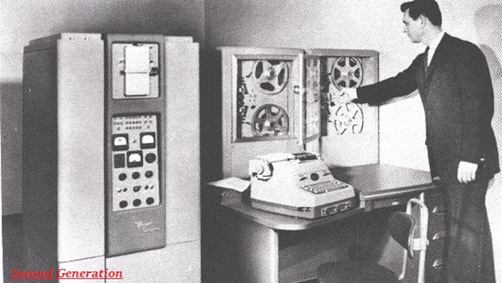
History of Computer Hardware

Slide 17
History of Computer Hardware
The main features of the second generation are −
Use of transistors
Reliable in comparison to first generation computers
Smaller size as compared to first generation computers
Generated less heat as compared to first generation computers
Consumed less electricity as compared to first generation computers
Faster than first generation computers
Still very costly
AC required
Supported machine and assembly languages

Slide 18
History of Computer Hardware
Some computers of this generation were −
IBM 1620
IBM 7094
CDC 1604
CDC 3600
UNIVAC 1108

Slide 19
History of Computer Hardware
Advantages:
Due to the presence of transistors instead of vacuum tubes, the size of electron component decreased. This resulted in reducing the size of a computer as compared to first generation computers.
Less energy and not produce as much heat as the first generation.
Assembly language and punch cards were used for input.
Low cost than first generation computers.
Better speed, calculate data in microseconds.
Better portability as compared to first generation
Disadvantages:
A cooling system was required.
Constant maintenance was required.
Only used for specific purposes.

Slide 20
History of Computer Hardware
Third Generation
The period 1963 to 1971 is roughly considered as the period of Third Generation of computers.
The third generation computers were developed by using the Integrated Circuit (IC) technology.
The computer system of the computers of the third generation was easier for commercial use.

Slide 21
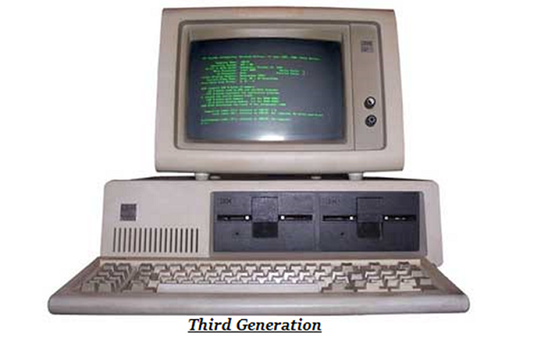
History of Computer Hardware

Slide 22
History of Computer Hardware
The main features of the third generation are −
IC used
More reliable in comparison to previous two generations
Smaller size
Generated less heat
Faster
Lesser maintenance
Costly
AC required
Consumed lesser electricity
Supported high-level language

Slide 23
History of Computer Hardware
Some computers of this generation were −
IBM-360 series
Honeywell-6000 series
PDP (Personal Data Processor)
IBM-370/168
TDC-316

Slide 24
History of Computer Hardware
Advantages:
These computers were cheaper as compared to second-generation computers.
They were fast and reliable.
Use of IC in the computer provides the small size of the computer.
IC not only reduce the size of the computer but it also improves the performance of the computer as compared to previous computers.
This generation of computers has big storage capacity.
Instead of punch cards, mouse and keyboard are used for input.
They used an operating system for better resource management and used the concept of time-sharing and multiple programming.
These computers reduce the computational time from microseconds to nanoseconds.
Disadvantages:
IC chips are difficult to maintain.
The highly sophisticated technology required for the manufacturing of IC chips.
Air conditioning is required.

Slide 25
History of Computer Hardware
Fourth Generation
The period 1971 to 2010 is roughly considered as the fourth generation of computers.
The fourth generation computers were developed by using microprocessor technology.
The production cost reduced to very low in comparison to the previous generation.
It became available for the common people as well.

Slide 26
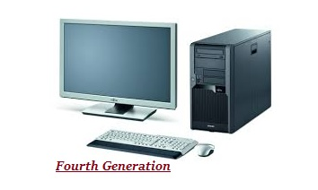
History of Computer Hardware

Slide 27
History of Computer Hardware
The main features of the fourth generation are −
VLSI technology used
Very cheap
Portable and reliable
Use of PCs
Very small size
Pipeline processing
No AC required
Concept of internet was introduced
Great developments in the fields of networks
Computers became easily available

Slide 28
History of Computer Hardware
Some computers of this generation were −
DEC 10
STAR 1000
PDP 11
CRAY-1(Super Computer)
CRAY-X-MP(Super Computer)

Slide 29
History of Computer Hardware
Advantages:
Fastest in computation and size get reduced as compared to the previous generation of computer.
Heat generated is negligible.
Small in size as compared to previous generation computers.
Less maintenance is required.
All types of high-level language can be used in this type of computers.
Disadvantages:
The Microprocessor design and fabrication are very complex.
Air conditioning is required in many cases due to the presence of ICs.
Advance technology is required to make the ICs.

Slide 30
History of Computer Hardware
Fifth Generation
The period 2010 to till date and beyond, roughly considered as the period of fifth generation of computers.
By the time, the computer generation was being categorized on the basis of hardware only, but the fifth generation technology also included software.
The computers of the fifth generation had high capability and large memory capacity.
Working with computers of this generation was fast and multiple tasks could be performed simultaneously.
Some of the popular advanced technologies of the fifth generation include Artificial intelligence, Quantum computation, Nanotechnology, Parallel processing, etc.

Slide 31
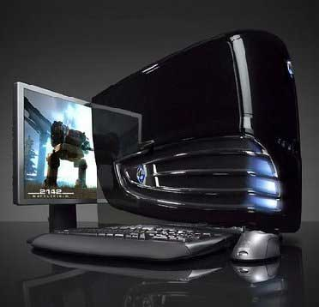
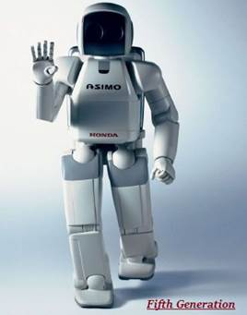
History of Computer Hardware

Slide 32
History of Computer Hardware
The main features of the fifth generation are −
ULSI technology
Development of true artificial intelligence
Development of Natural language processing
Advancement in Parallel Processing
Advancement in Superconductor technology
More user-friendly interfaces with multimedia features
Availability of very powerful and compact computers at cheaper rates

Slide 33
History of Computer Hardware
Some computers of this generation were −
Desktop
Laptop
NoteBook
UltraBook
ChromeBook

Slide 34
History of Computer Hardware
Advantages:
It is more reliable and works faster.
It is available in different sizes and unique features.
It provides computers with more user-friendly interfaces with multimedia features.
Disadvantages:
They need very low-level languages.
They may make the human brains dull and doomed.

Slide 35
History of Software
Programming Language
Late 1940’s
Binary Code
Native computer language
Consists only of 0s and 1s
0’s = off
1’s = on
Difficult for humans to read, write, and debug
Fast and efficient, executed directly on the CPU

Slide 36
History of Software
Programming Language
Early 1950’s
Assembly languages
Simple mnemonic instructions <opcode> <operands>
Assembler translates into machine code
Specific to each type of processor, not portable

Slide 37
History of Software
Programming Language
Mid 1950’s - Present
High level, general-purpose
FORTRAN(1950’s), LISP(1958), COBOL(1959), ALGOL, Basic (1964), Ada, C(1972)
Easier for humans to read, write, debug
Portable – can be run on two or more kinds of processors
High level languages are handle in two ways
Compiler translates into machine code before running
Interpreter translates into machine code at runtime

Slide 38
History of Software
Programming Language
Fortran
Among the earliest programming languages
Well-suited for mathematical calculations
Today used in some of the most demanding supercomputing tasks
Weather and climate modeling
LISP
Created as a practical mathematical notation for computers
Link lists are one of Lisp language's major data structures
Favored programming language for artificial intelligence (AI) research

Slide 39
History of Software
Programming Language
COBOL
Popular for business data-processing on larger computers
Designed for use by Banks, utility companies, manufactures, government agencies and other big companies.
Pascal
Named after mathematician, Blaise Pascal
Put into practice structured programming – easier to read, write, debug
Easy to learn and often used in beginning programming classes

Slide 40
History of Software
Programming Language
Mid 1960’s - present
Object-Oriented Programming (OOP)
Simula(1960’s),Smalltalk(1970’s), C++(1980’s), C#, Eiffel, Java (1990’s), Objective-C, C#, Perl, Python, Ruby, PHP
Using Objects allowing programmers to write code independent of specific application.
Designing modules of reusable software systems
Objects contain both data and functions
Easily used across multiple systems

Slide 41
History of Software
Programming Language
Specific Languages (1970’s – present)
Query languages, report generators, systems engineering
Maple, Mathematica, Postscript, SPSS, SQL
Logic programming languages(1980s - ):
Solve problems using constraints rather than algorithms, used in Artificial Intelligence
Prolog - natural language processing

Slide 42
History of Software
Programming Language
World Wide Web (1990 – present)
Internet languages allow everyday people to access information stored on the web
HTML, JavaScript, PHP, Java, ASP, ASP.Net
HTML (Hyper Markup Language) is a basic language for building web pages
JavaScript (1995) – Allows web pages to be interactive
PHP is a general purpose language designed to produce dynamic Web pages.

Slide 43
History of Software
Operating System
First generation
vacuum tubes, plug boards
Still very slow and used for scientific calculations
No OS was needed
Programs were entered by setting some switches

Slide 44
History of Software
Operating System
Second generation 1955 – 1965
transistors, batch systems
Universities started to buy computers (spending millions of dollars)
Punched cards were used
To run a job (a program or a set of related programs) first punch it and give the deck to the operators and wait for the output (batch operation)
Computers were single user
IBM STRETCH
DEC PDP-1

Slide 45
History of Software
Operating System
Third generation – 1980
Integrated Circuits
Multiprogramming system
Third generation OSs were still not interactive, i.e., whenever there is an error, programmers would realize it after a couple of hours.
This problem lead to timesharing systems

Slide 46
History of Software
Operating System
Fourth generation 1980 – present
Personal computers were developed after LSI (Large Scale Integration) circuits were invented
First disk based OS CP/M (Control Program for Microcomputers)
In 1980s IBM designed the IBM PC and contacted Bill Gates for an operating System

Slide 47
History of Software
Operating System
1956, GM-NAA I/O (General Motors and North American Aviation )
Robert L. Patrick-GM Motors
IBM 704 Mainframes
1961, MCP (Master Control Program)
Burroughs Corporations
B5000 mainframe
1966, DOS/360
Unsuccessful Mainframes
DOS/360
1969, Unix
AT&T Bell Labs
Ken Thompson, Dennis Ritchie
Written in C language

Slide 48
History of Software
Operating System
1973, CP/M (Control Program/Monitor)
Greg Kildall
WordStar and dBASE
IBM wanted CP/M
1977, BSD (Berkeley Software Distribution)
University of California, Berkeley
Early versions of Unix
1981, MS-DOS
Microsoft for the IBM PC’s
For home users

Slide 49
History of Software
Operating System
1982, SunOS
Sun Microsystems
Based on BSD (Berkley software distribution)
1984, Macintosh OS
Apple Computer
GUI (Graphical User Interface) built-in
1985, Microsoft Windows
Microsoft
Graphical user interface (GUI)

Slide 50
History of Software
Operating System
1987, OS/2
IBM and Microsoft
Unpopular
1991, Linux
Linus Torvalds
Open Source project
1992, Sun Solaris
Sun Microsystems
Unix variant

Slide 51
History of Software
Operating System
1993, Windows NT
Microsoft
Server Operating System
1995, Windows95
Microsoft
GUI built-in
“Start” button
1997, JavaOS
Sun Microsystems
Java programming language

Slide 52
History of Software
Operating System
1998, Windows98
Microsoft
The next iteration of the Microsoft Windows95
1999, MacOS X Server 1.0
Apple Computer
Precursor to Apple’s MacOS X desktop
2000, Windows 2000
Microsoft
Different code base

Slide 53
History of Software
Operating System
2000, Windows ME
Microsoft
Unsuccessful new version
2001, MacOS X Version 10.0
Apple Computer
Changed the user interface
2001, Windows XP
Microsoft
Enhanced version of Windows 2000
Used for long time

Slide 54
History of Software
Operating System
2003, Windows Server 2003
Microsoft
Improved version of Windows NT OS
2007, Windows Vista
Microsoft
Flopped version
2008, Windows Server 2008
Microsoft
Upgrade to Windows Server 2003.

Slide 55
History of Software
Operating System
2009, Windows 7
Microsoft
Multi-touch
Internet Explorer 8
Improved security
2012, Windows 8
Microsoft
Uses in Windows Phone
Metro user interface
Supports both x86 PCs and ARM processors.

Slide 56
History of Software
Operating System
Windows 10
Microsoft
Fast start up
Built-in security
Start Menu in an expanded form
Microsoft Edge

Slide 57
Chapter 1 : Assignment Presentation
History of Networking:
Pioneers of Computing :

Slide 58
Thank You

